Slide 1

Registration Procedure Modeling

Slide 2

Contents
Introduction to 5G
Overview Of 5G Network Architecture
Introduction to 5G Registration Procedure
Importance Of Registration Procedure
Types Of Registration
Criteria For Designing The 5G Registration Model
Data Flow Diagram
System Design And Development
Step-by-Step Registration Process
PCAP Captures
Challenges And Solutions
Conclusion

Slide 3
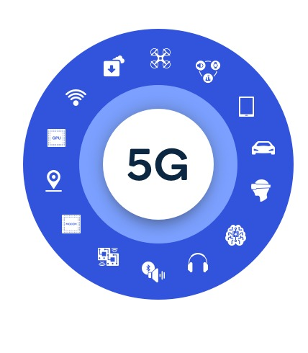
Introduction to 5G
5G is the fifth generation of mobile networks, following 4G (LTE), 3G, and 2G.
Each generation has brought advancements in speed, capacity, and connectivity.
Enhanced Mobile Broadband (eMBB): Delivers high data rates and increased capacity for ultra-high-definition video streaming and virtual reality.
Ultra-Reliable Low-Latency Communication (URLLC): Supports real-time applications like autonomous driving and remote surgery.
Massive Machine Type Communication (MMTC): Connects a vast number of IoT devices, supporting smart cities and industrial applications.
The 5G registration procedure involves an intricate process through which devices connect and authenticate with the 5G network.

Slide 4
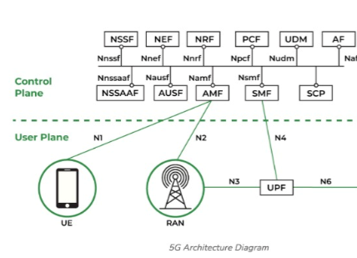
Overview Of 5G Network Architecture
The fifth generation mobile network is a new global wireless standard after 1G, 2G, 3G, and 4G networks delivering up to 20 Gigabits-per-second (Gbps) peak data rates and 100+ Megabits-per-second (Mbps) average data rates. 5G will use orthogonal frequency-division multiplexing (OFDM) encoding bonded up to between 100 and 800 MHz channels.
The evolution of the mobile world is not all that 5G is, therefore the breadth of 5G extends beyond mobile communication to address all forms of communication services; in fact, it is truly supporting the future of the digital world by enabling all types of services, including critical/non-critical, voice/non-voice, and IoT. Promoting economic change across all sectors and utilizing all diverse technologies ( WiFi, 4G, and new radio technologies).

Slide 5

Key Components of 5G Registration
User Equipment (UE): Mobile devices such as smartphones, tablets, IoT devices. UE is the endpoint device that interacts with the network.
gNB (Next-generation Node B): The 5G base station that communicates with the UE. It handles radio communications and connects to the core network.
AMF (Access and Mobility Management Function): Manages connection and mobility aspects, ensuring that the UE stays connected and manages handovers.
SMF (Session Management Function): Manages session establishment, modification, and release, handling data sessions and IP address allocation.
UPF (User Plane Function): Handles data traffic routing to and from the UE, ensuring efficient data delivery and traffic management

Slide 6
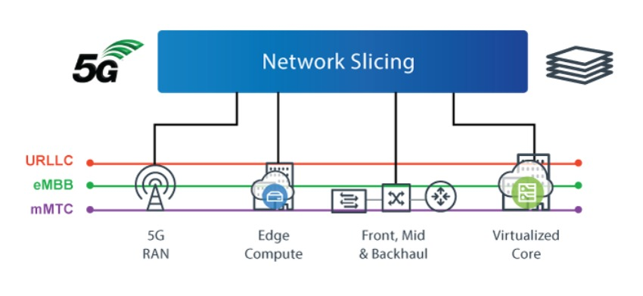
Network Slicing And Its Importance
Network slicing: Network slicing is a method of creating multiple virtual networks on a shared physical infrastructure.
Importance and benefits:
Allows multiple virtual networks on a shared physical infrastructure. Supports different types of services with specific requirements. Enhances resource efficiency and service delivery .
Enables customized network services for different use cases (e.g., IoT, enhanced mobile broadband).

Slide 7
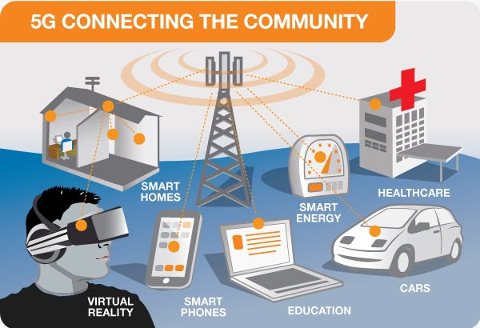
Introduction Of Registration Procedure
When you connect to a 5G network, your device goes through a registration process to securely connect. It starts with your device contacting a nearby tower, followed by establishing a dedicated channel. The device then sends its identity and credentials to the core network for verification. After the network confirms everything is in order, it assigns a temporary identifier and configures your device for data transfer. This entire process happens behind the scenes, allowing you to seamlessly enjoy the benefits of 5G.

Slide 8
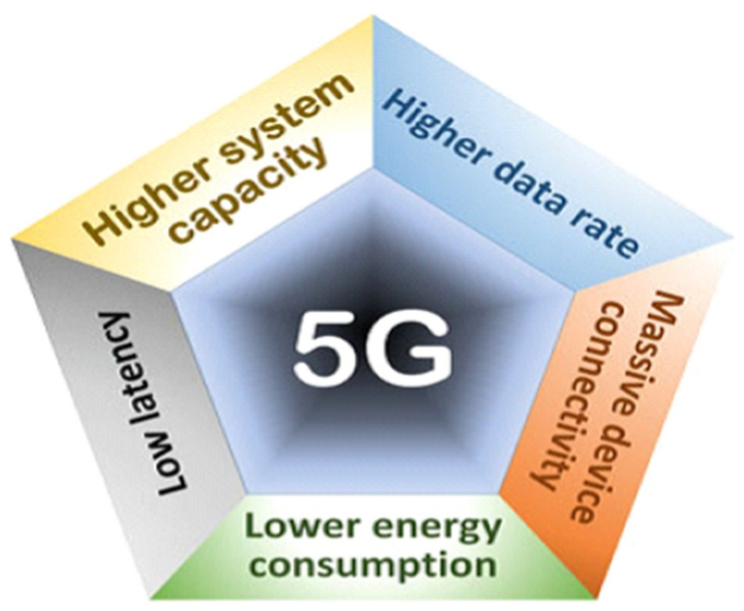
Importance Of Registration Procedure…
Authentication: Verifies the identity of devices to prevent unauthorized access.
Encryption: Protects data integrity and confidentiality during communication.
Network Resource Allocation: Optimizes the use of network resources to ensure high performance.
Handover Management: Ensures smooth transitions between network cells without service interruption.
Continuous Connectivity: Maintains ongoing sessions as users move, providing a seamless user experience.
QoS Management: Ensures that different types of traffic (e.g., video streaming, voice calls, IoT data) receive appropriate levels of service.
Latency Reduction: Facilitates low-latency communication for applications requiring real-time responsiveness, such as autonomous vehicles and remote surgery.
Device Capability Detection: Identifies device capabilities to tailor network services accordingly.
Energy Efficiency: Manages device and network energy consumption efficiently, extending battery life and reducing operational costs.

Slide 9
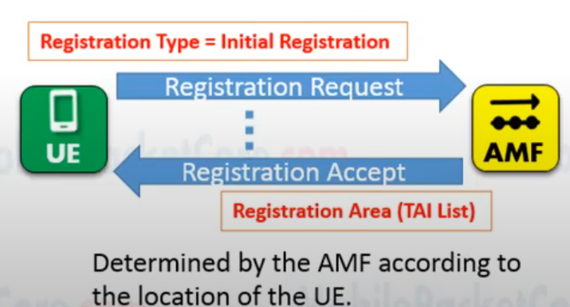
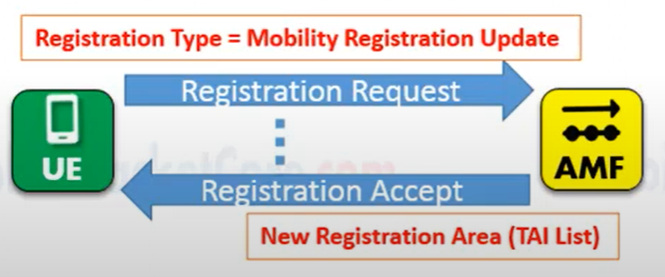
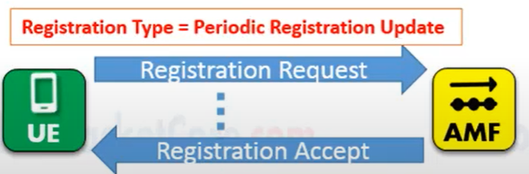
Types Of Registration
In 5G networks, there are several types of registration procedures that a user equipment (UE) can perform to connect to and interact with the network. Here are the main types of registration in 5G:
Initial Registration is a mandatory procedure that UEs must execute when they are first powered on. After completing this procedure, the core network will allocate the corresponding resources to the UE. If the UE is in the Idle state (CM-Idle) for a long period of time, causing the core network to lose the UE Context, the UE must also initiate this procedure.
Mobility Registration is a procedure that UEs must initiate when they move to a new Tracking Area (TA) that is not included in the UE's TAI List. This procedure is used to update the TA information.
Periodic Registration (PR): After the initial registration, user devices periodically update their registration with the network. This ensures that the network always knows the device’s current location and status. Periodic registration helps with seamless mobility management.

Slide 10
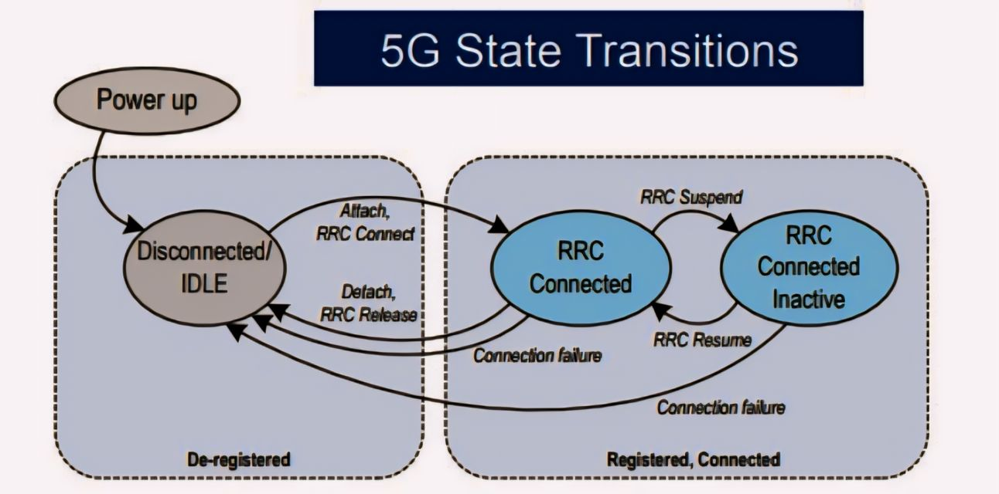
Criteria For Designing The 5G Registration Model
The Radio Resource Control (RRC) protocol manages the connection between the User Equipment (UE) and the Radio Access Network (RAN). The RRC protocol has several states that define how the UE interacts with the network. Here are the main RRC states in 5G:
RRC_IDLE:
The RRC_IDLE state is a low-power state where the User Equipment (UE), such as your smartphone, is not actively transmitting or receiving data.
RRC_INACTIVE:
A state between RRC_IDLE and RRC_CONNECTED that allows faster transition to an active state while saving battery life.
RRC_CONNECTED:
The RRC_CONNECTED state in 5G is when the User Equipment (UE) is actively communicating with the network.

Slide 11
Criteria For Designing The 5G Registration Model…
Disconnected/Idle : The device is powered off or not connected to the network Transitions.
Power up: The device turns on and moves to the Idle state. Attach, RRC Connect: The device connects to the network, transitioning to the RRC Connected state Detach.
RRC Release: The device disconnects from the network and goes back to the Disconnected/Idle state.
RRC Connected : The device is actively connected to the network and can send and receive data Transitions.
RRC Suspend: The device suspends its active connection, transitioning to the RRC Connected Inactive state.
Connection failure: If the connection fails, the device moves back to the Disconnected/Idle state.
RRC Connected Inactive :The device maintains a registered but inactive connection with the network. It can quickly resume an active connection when needed Transitions.
RRC Resume: The device resumes its active connection, moving back to the RRC Connected state.
Connection failure: If the inactive connection fails, the device goes back to the Disconnected/Idle state.

Slide 12

Criteria For Designing The 5G Registration Model…
Initial Access Procedure :
UE searches for an available cell and requests access by sending a registration request .
Network responds with RRC connection setup messages .
UE sends NAS Registration Request message to AMF.
NAS Security Setup :
UE and network establish NAS security keys to secure subsequent NAS messages .
Security algorithms are negotiated, and keys are derived.
Authentication and Authorization :
Network verifies the UE's identity using authentication vectors. Ensures that the UE is authorized to access network services.
Involves exchange of authentication request and response messages between UE and AMF
Registration Accept/Reject :
Network sends a registration accept message if the process is successful, including necessary parameters (e.g., assigned AMF, security keys).
If unsuccessful, a registration reject message is sent detailing the reason

Slide 13
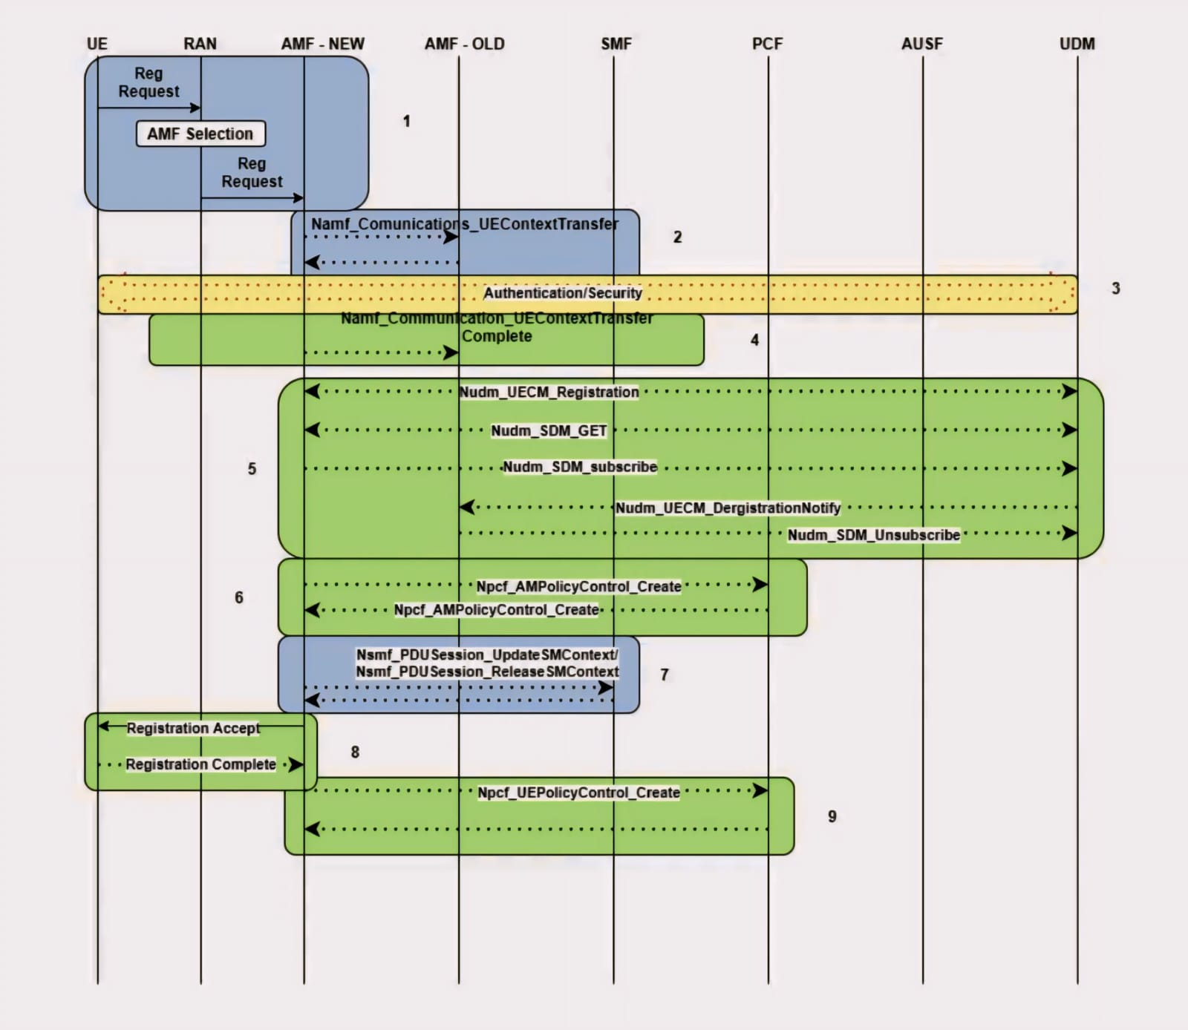
Data Flow Diagram

Slide 14
System Design And Development
7
Request
Response
4
6
AUSF discovery
UDM discovery
5
NRF
Authenticate Request
AUSF
UDM
1
2
8
Registration type: Initial Registration
SUCI/5G-GUTI
Security parameters
Requested NSSAI
Registration type: Initial Registration
SUCI/5G-GUTI
Security parameters
Requested NSSAI
Authenticate Response
10
Request
Response
RAN
AMF
3
9
11
RRC
NGAP
NAS
HTTP (Service based)
PFCP
Identity Request
Identity Response
Auth-Req
Auth-Res
SUCCESS
PCF
Notes:
UE to RAN: AN Message The UE sends AN message to the RAN, including AN parameters and an RM-NAS Registration Request. The AN parameters include e.g. SUCI or SUPI or the 5G-GUTI, the Selected PLMN ID and Requested NSSAI, the AN parameters also include Establishment cause. The Establishment cause provides the reason for requesting the establishment of an RRC connection. The Security parameters are used for Authentication and integrity protection. Requested NSSAI indicates the Network Slice Selection Assistance Information.
The RAN, selects an AMF based on RAT and Requested NSSAI, if available. RAN to AMF: N2 Message When NG-RAN is used, the N2 parameters include the Selected PLMN ID, Location Information, Cell Identity, the RAT type related to the cell in which the UE is camping, and the Establishment cause.
AMF to UE: Identity Request If the SUPI or SUCI is not provided by the UE the Identity Request procedure is initiated by the AMF sending an Identity Request message to the UE requesting the SUCI. UE to AMF: Identity Response The UE responds with an Identity Response message including the SUCI. The UE derives the SUCI by using the provisioned public key of the HPLMN.

Slide 15
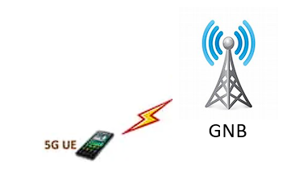
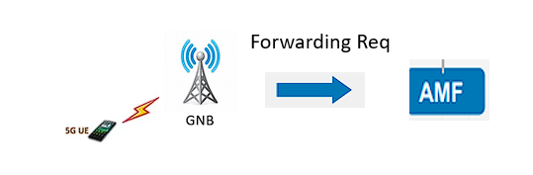
Step-by-Step Registration Process
The 5G User Equipment (UE) establishes a radio connection with the gNodeB (gNB) through the Random Access Procedure, initiating communication by sending a Random Access Preamble and receiving a Random Access Response. The gNB then serves as the intermediary, forwarding the UE's registration and service requests to the 5G core network.
The gNodeB (gNB) forwards the UE's registration and service requests to the Access and Mobility Management Function (AMF), acting as a relay to ensure the UE's information reaches the 5G core network. The AMF processes these requests, managing authentication, subscription data, and mobility functions.

Slide 16
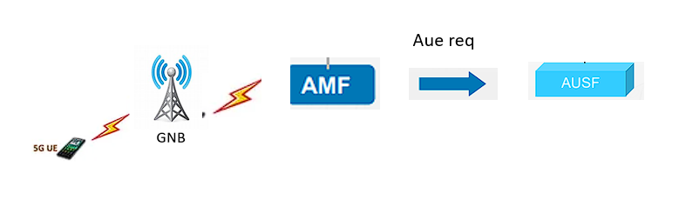
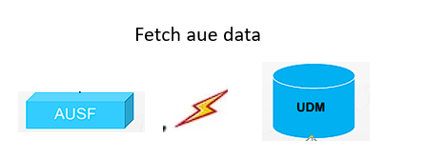
Step-by-Step Registration Process…
The Access and Mobility Management Function (AMF) sends an authentication request to the Authentication Server Function (AUSF) to authenticate the UE. The AUSF generates the necessary authentication vectors and provides them back to the AMF for verification
The AUSF (Authentication Server Function) communicates with the UDM (Unified Data Management) in 5G networks to retrieve subscription information and authentication credentials associated with the User Equipment (UE). This interaction allows the AUSF to authenticate UEs and authorize their access to network services based on their subscription profiles stored in the UDM.

Slide 17
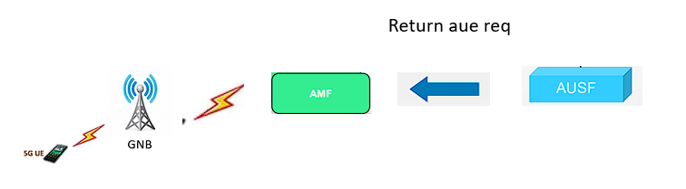
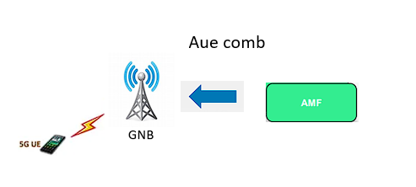
Step-by-Step Registration Process…
The AUSF (Authentication Server Function) communicates with the AMF (Access and Mobility Management Function) in 5G networks to provide authentication vectors and assist in authentication and authorization processes for User Equipment (UE). This ensures that UEs can securely access and use network services according to their subscription and authentication status.
The AMF (Access and Mobility Management Function) in 5G networks directly manages and coordinates communication, authentication, and mobility functions with the User Equipment (UE), ensuring seamless connectivity and service delivery across the network.

Slide 18
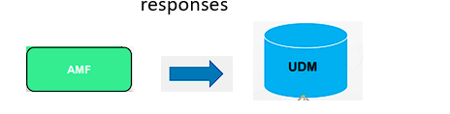
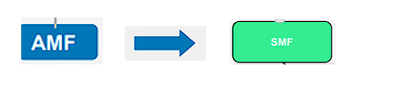
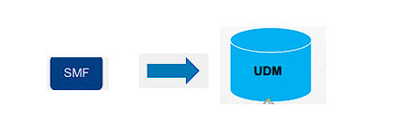
Step-by-Step Registration Process…
The AMF (Access and Mobility Management Function) communicates with the UDM (Unified Data Management) in 5G networks to retrieve subscriber data and manage mobility and session information for User Equipment (UE), ensuring efficient network operation and service delivery.
The AMF (Access and Mobility Management Function) in 5G networks communicates with the SMF (Session Management Function) to manage and control user sessions, ensuring efficient data routing and service delivery according to network policies and user preferences.
The SMF (Session Management Function) communicates with the UPF (User Plane Function) using User Plane Protocol (PDU Session Protocol) to manage and direct user data flows in 5G networks. This protocol ensures efficient handling of user data packets, including routing, quality of service (QoS) management, and other network optimizations.

Slide 19
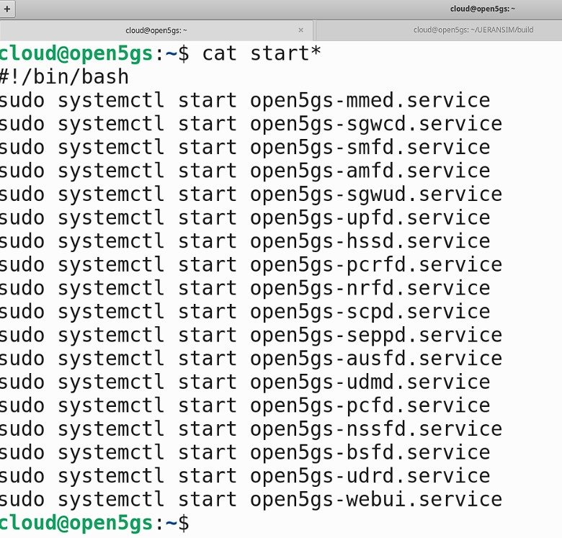
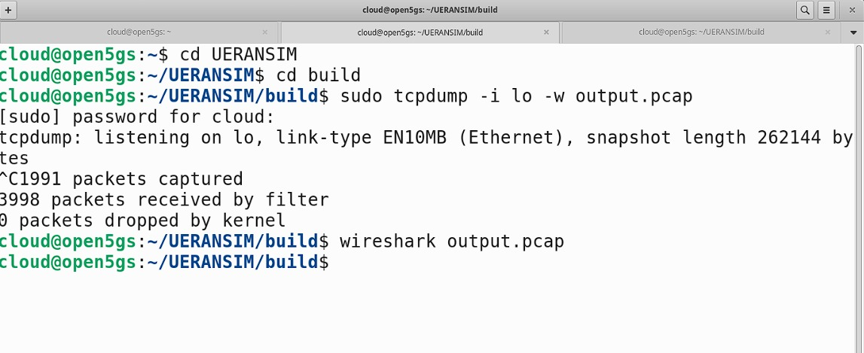
PCAP Captures

Slide 20
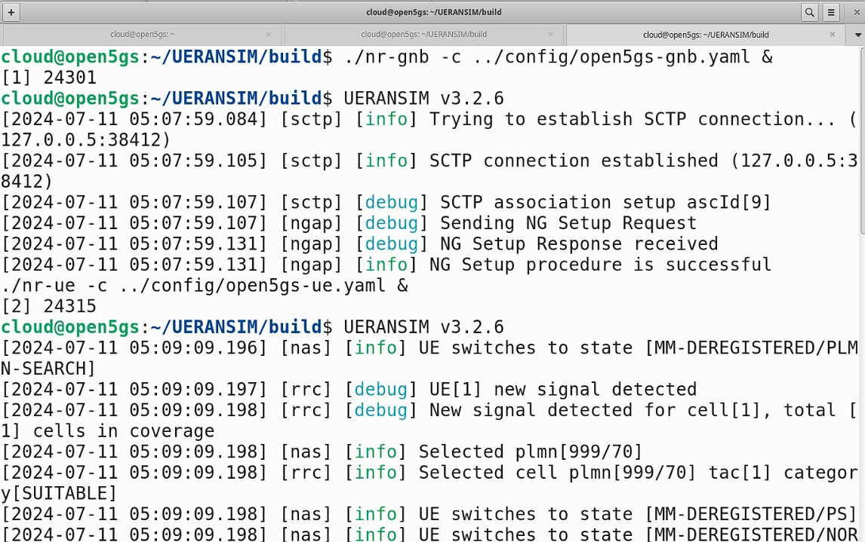
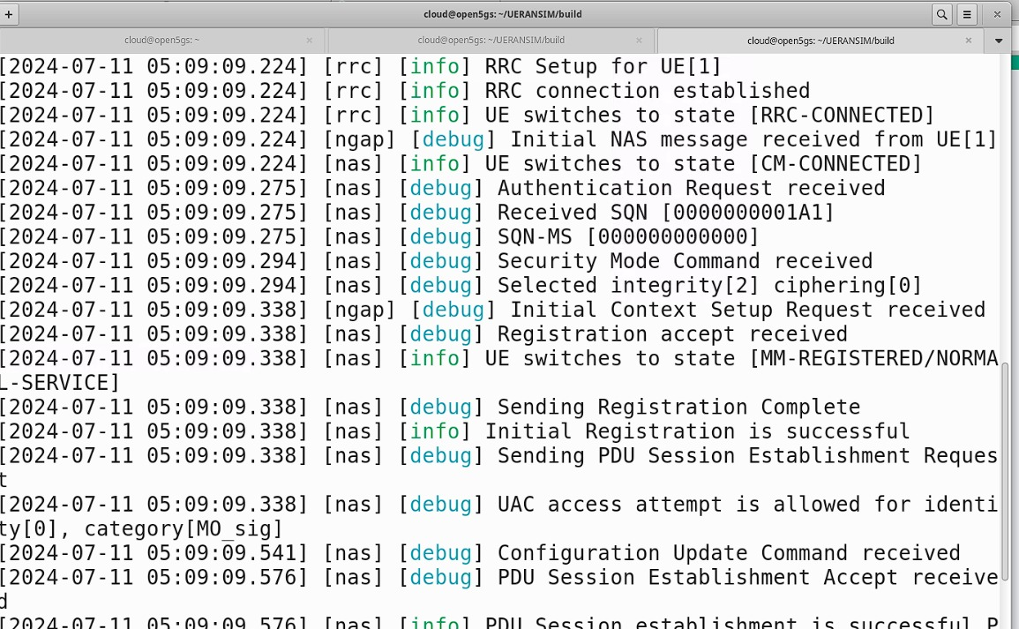
PCAP Captures…

Slide 21
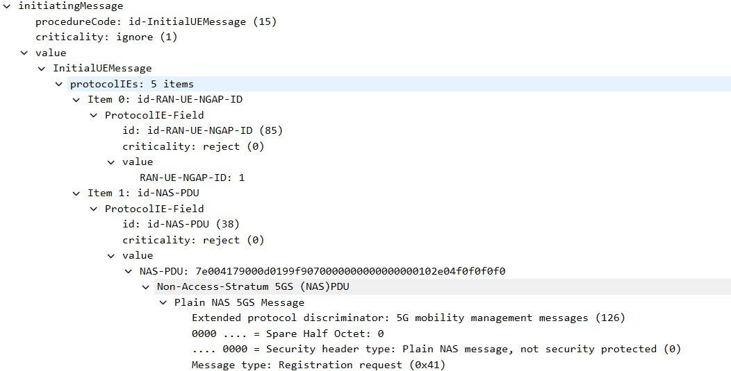
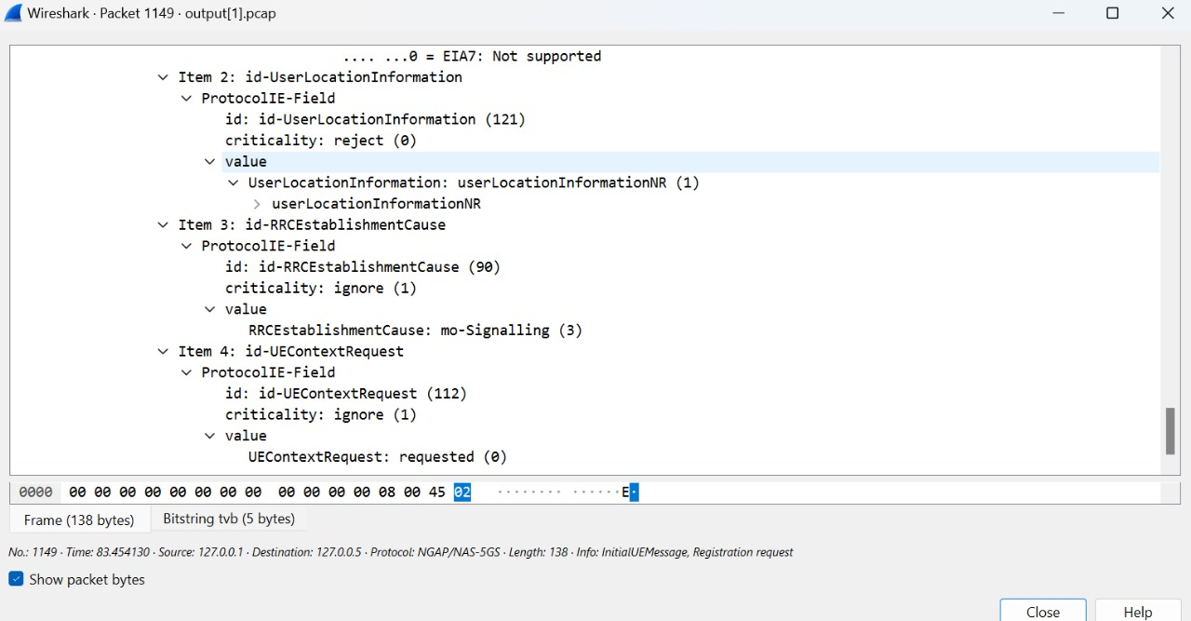
PCAP Captures…

Slide 22
Challenges And Solutions of 5G
Infrastructure Investment
Security Concerns
Spectrum Allocation
Energy Efficiency
Interoperability
Regulatory Compliance
Public Resistance and Perception
Complex Network Management

Slide 23
Conclusion
In conclusion, the 5G registration process is a crucial aspect of the network's functionality, ensuring that devices can connect seamlessly and securely. By understanding the architecture and the signaling protocols involved, such as NAS, RRC, and S1AP, we can appreciate the complexity and importance of each step in the registration procedure. Our model highlights the essential procedures, from initial access to authentication and authorization, providing a comprehensive view of the registration process. Despite the challenges faced during this project, including the intricacies of signaling protocols and integration of NGAP and XNAP, we successfully developed a detailed representation of the 5G registration procedure. This model not only demonstrates the technical aspects but also underscores the importance of efficient and secure registration in the overall 5G ecosystem.

Slide 24
References
https://www.etsi.org/deliver/etsi_ts/123500_123599/123501/15.02.00_60/ts_123501v150200p.pdf
https://www.etsi.org/deliver/etsi_ts/123500_123599/123502/18.05.00_60/ts_123502v180500p.pdf
https://www.etsi.org/deliver/etsi_ts/138400_138499/138413/16.02.00_60/ts_138413v160200p.pdf
Authors: Wanshi Chen, Peter Gaal, Juan Montojo, and Haris Zisimopoulos

Slide 25



